Slide 1
PixDroid
Team 12

Slide 2




PixDroid

Slide 3
PixDroid
do something
with
the Pictures
an App to XXX
PixDroid
Purpose tool
audience
Notes:
Here comes our app.
Tag tools

Slide 4
PixDroid
Alternative Android Album App
Classify Pictures in your Gallery
· Favorite (Mark)
· Archive (Hide)
· Trash (Delete)
In a Friendly way
· Gesture
TOOL

Slide 5

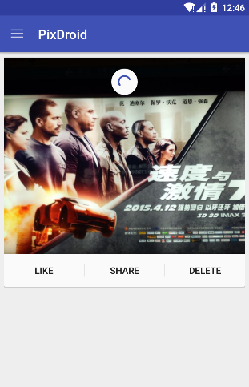
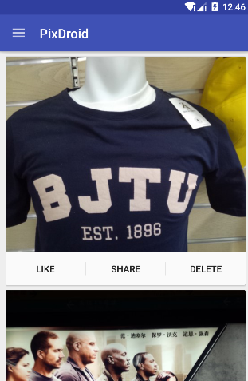
PixDroid
Load Picture

Slide 6
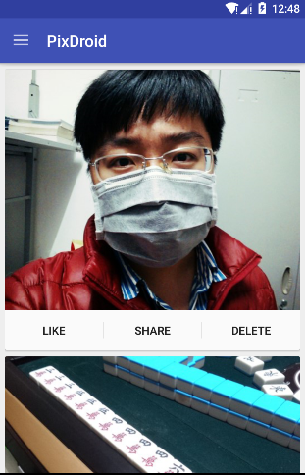
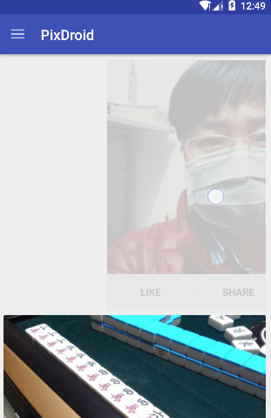
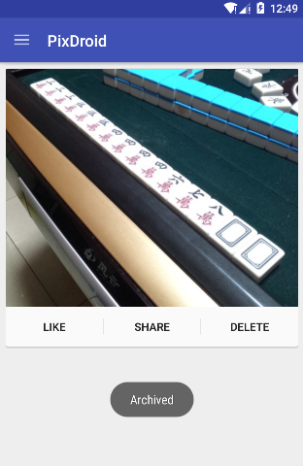
PixDroid
Archive(File) Picture

Slide 7
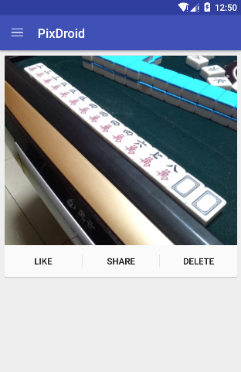
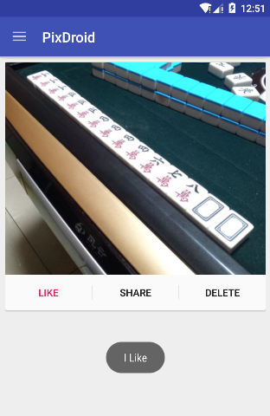
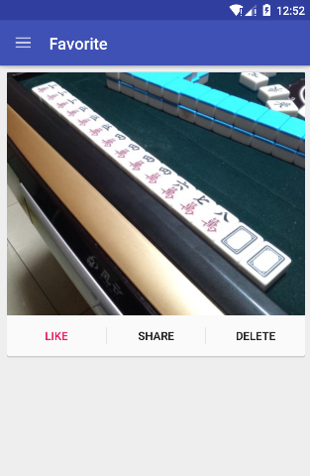
PixDroid
Like Picture

Slide 8

PixDroid

Slide 9
PixDroid
Feature
· Material Design
· Gesture
· Below API 5.0 Also Supported (MinSDK: API 16)

Slide 10
PixDroid
Difficult Point
· RecyclerView (new in API 5.0)
RecyclerView
Adapter
LayoutManager
Dataset
·Convient to custom the Animator(Swipe & Dismiss)
·Use a Open-source Library on the Github

Slide 11

PixDroid
Next Steps
· Undo
· Settings - Preference
· Load Picture from Gallery

